Slide 1

TATA MOTORS

Slide 2
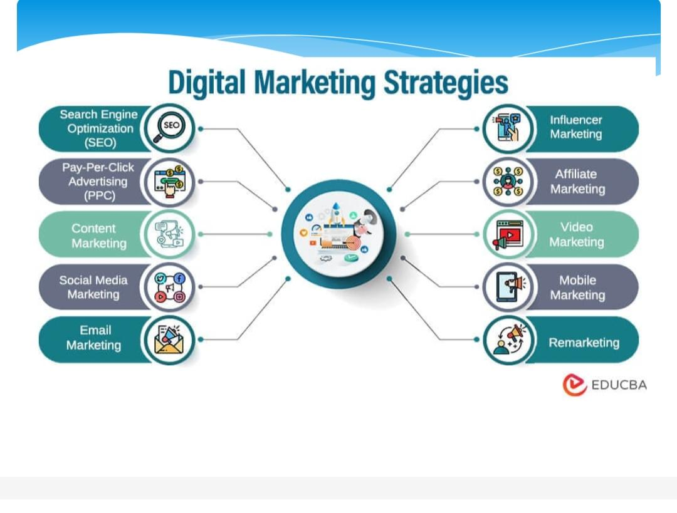

Slide 3
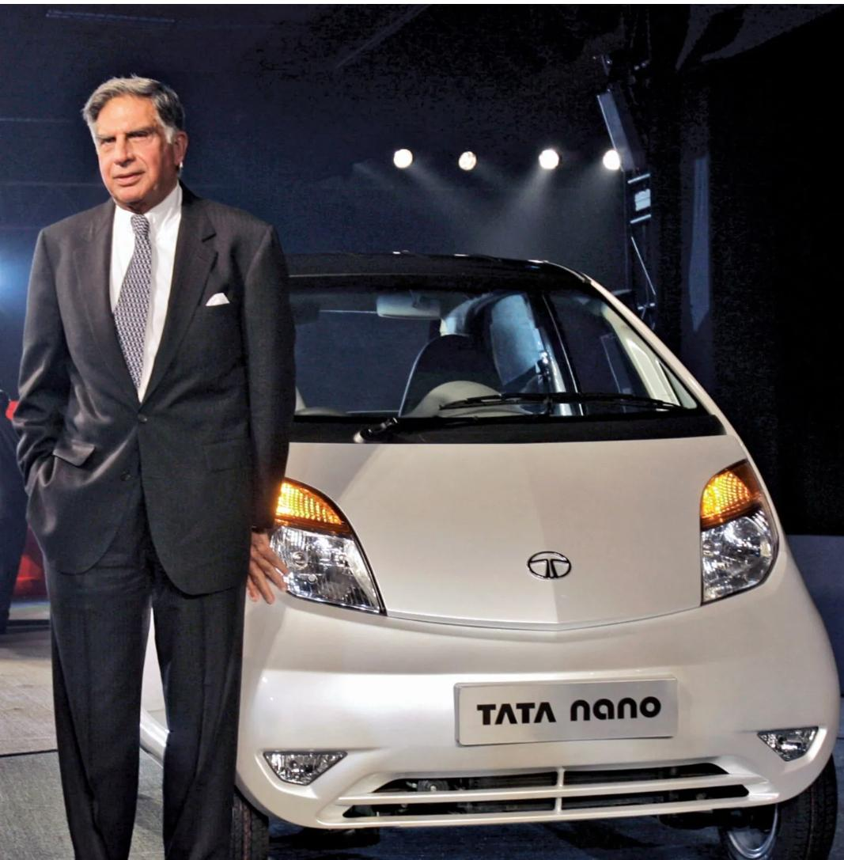
FOUNDER:
The Tata Group was founded as a private trading firm in 1868 by entrepreneur and philanthropist Jamsetji Nusserwanji Tata. In 1902 the group incorporated the Indian Hotels Company to commission the Taj Mahal Palace & Tower, the first luxury hotel in India, which opened the following year

Slide 4
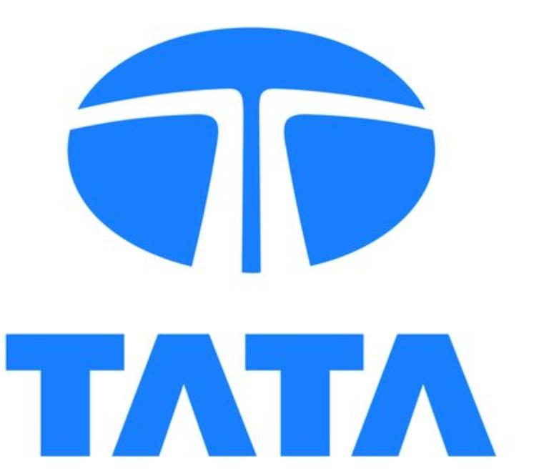
TATA is a well-known Indian multinational conglomerate company that operates in various sectors, including automotive, steel, information technology, telecommunications, and more. It is a brand name that does not have a full form, but it was originally derived from the name of its founder, Jamsetji Tata

Slide 5
Comprehensive Digital Marketing Project WorkOn Tata motors
Team Leader:Vanjyala Syamala
Team member: Potnuru Rajani
Team member:Savara Prameela
Team member: Segalla Neelima
Team member: Tandela Sravani

Slide 6
Part 1: Brand Study,Competitor Analysis&Buyer’s Audiences Persona
COMPETITOR TATA MOTORS
USP:The USP of Tata Motors is their focus on message execution and image building to associate the brand with positive imagery that impacts consumer perception and long-term reactions.
Online comunication:Tata Communications is a digital ecosystem enabler that powers today’s fast-growing digital economy. Tata Communications is a digital ecosystem enabler that powers today’s fast-growing digital economy.

Slide 7
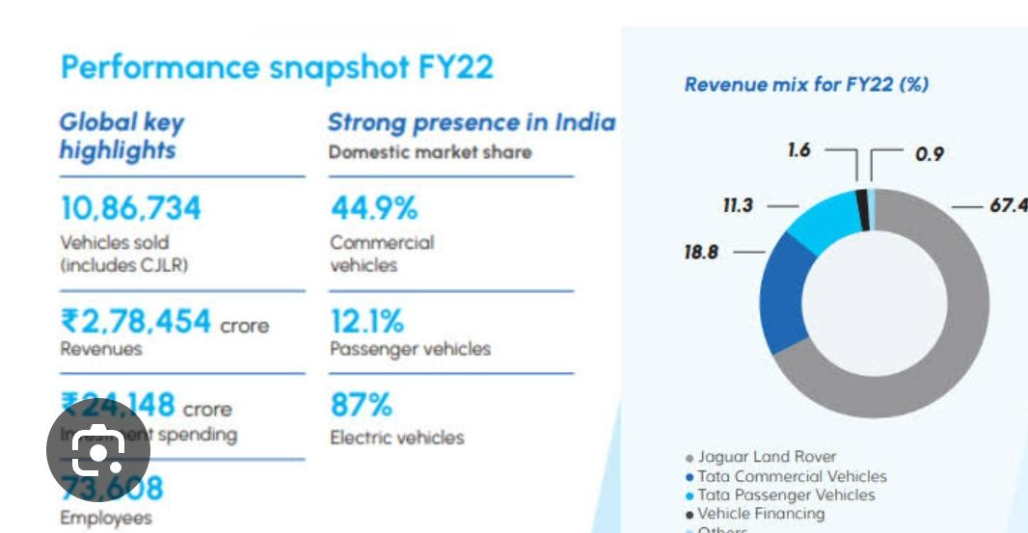
SWOT
Strength: Tata has 14% of India's automotive market share while Mahindra & Mahindra has a market share of 7.40%. Tata Motors has a presence in over 125 countries, with a worldwide network made up of over 8,800 touch points.

Slide 8
Weaknesses: Dependence on Domestic Market: A significant portion of Tata Motors’ revenue comes from the domestic Indian market. Economic fluctuations in India can impact the company’s performance. Competitive Challenges: Tata Motors faces fierce competition both in India and globally.
Opertunities:Tata Motors’ commercial vehicle (CV) segment’s growth is ahead of its competitors with a 9% market share in the commercial vehicle (CV) segment. Since 2021 Tata has consolidated sales while establishing itself as the best-performing EV car manufacturer in India, powered by sales from its flagship Nexon EV.

Slide 9
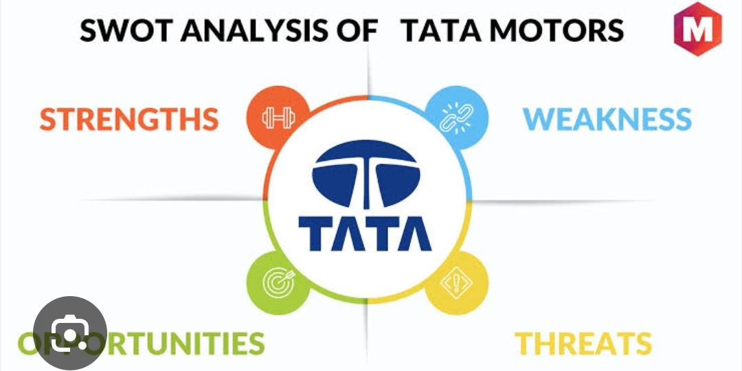
Thrats:Tata Motors admits it is experiencing stiff competition from domestic and foreign automobile manufacturers who have been attracted by India’s burgeoning automotive market.

Slide 10
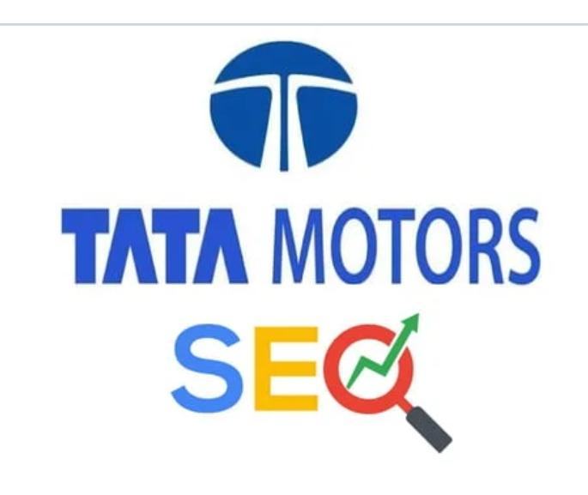
Part 2:SEO& Keyword Research
SEO Audit:ependent Auditors’ Report We have audited the standalone financial statements of Tata Motors Limited (“the. Company”), which comprise the standalone balance sheet as at
Keyword Research: Tata motors” are -, IN and SAU. Among them, the regional interest value of “tata motors” in – itata motors" are -, IN and SAU. Among them, the regional interest value of "tata motors" in - is -, in IN is 34, and in SAU is 11. This means that the primary audience for "tata motors" is in -, - and SAU. You need to adjust your promotion strategy according to this feature. Other than that, you might be interested in digital audience targeting.
According to AdTargeting, the top 5 rising and top keywords in "tata motors" of relevant words are listed below.

Slide 11
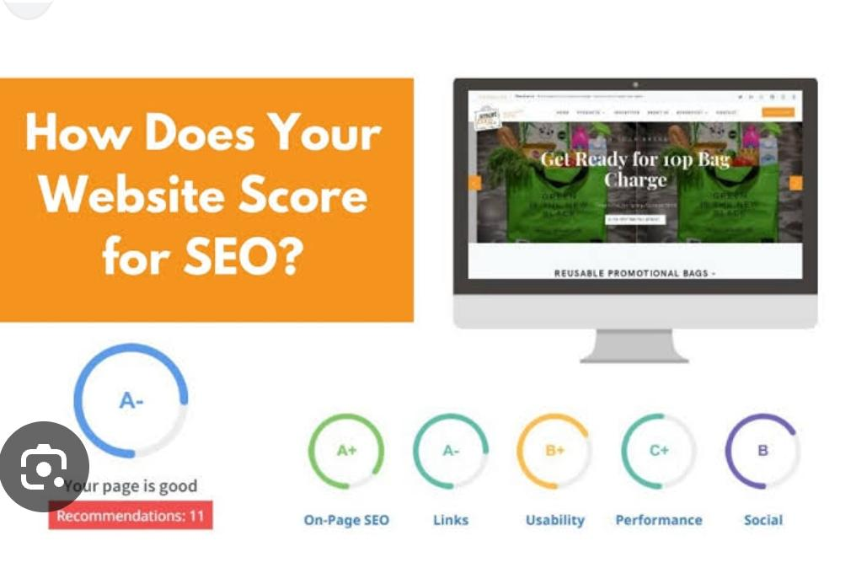
SEO Audit
SEO software features that can help you find coding errors and show you ways to correct it, accelerate website speed, improve loading errors and server optimizations that help search engine spiders crawl and index your website effectively for a better user experience.

Slide 12
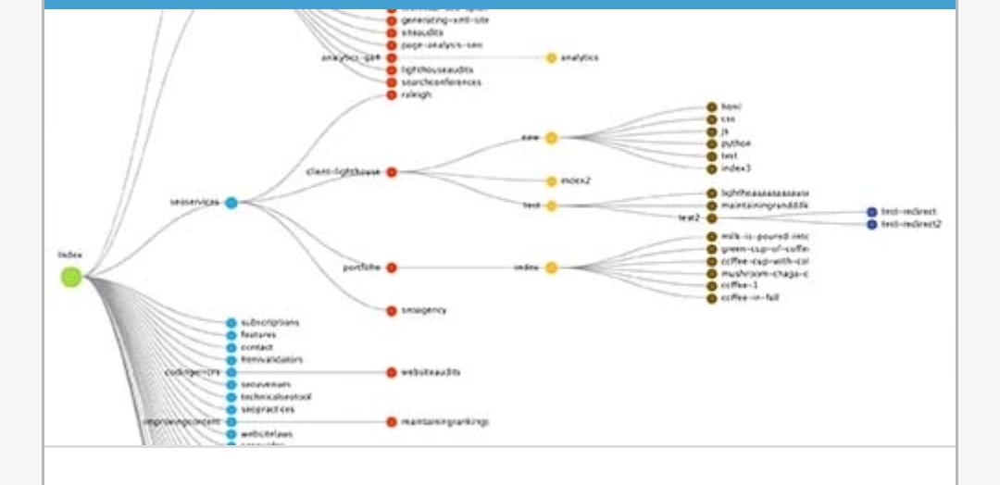
SEO Audit
Our Technical Spider Tool is a powerful website crawler that can help you discover issues and analyze the results in real time. You will be able to discover Technical SEO

Slide 13
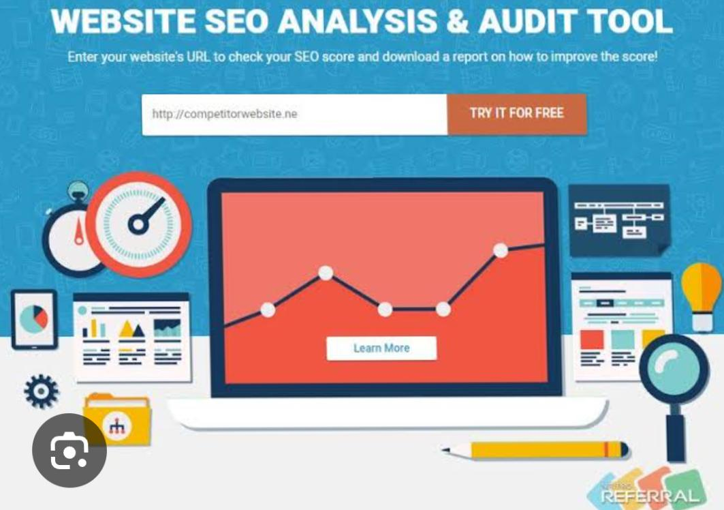
Keyword Research
TML’s focus is on strengthening market presence by offering solutions that meet and surpass customers’ expectations and deliver hassle-free sales and service experience to customers. JLR’s philosophy of ‘Customer First’ enables personalised and ‘easy to do with’ experience for its customers.

Slide 14
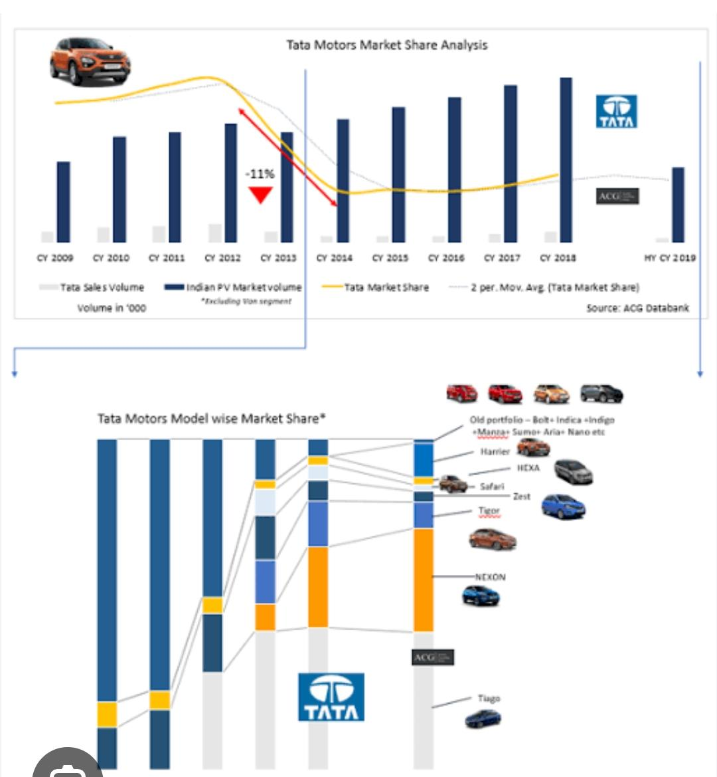
On Page SEO
Our comprehensive Technical SEO Spider tool is a fast, very effective way to analyze your site’s on-page SEO issues. Our web crawlers can be used on any device anywhere you are. When you conduct a website audit you will discover an overall view of every element of your site so you can improve your pages quickly with ease.

Slide 15
Part 3 Content Idea’s and Marketing Strategies
Content Marketing: Tata Motors creates engaging and informative content related to its products, such as videos, blog posts, and infographics. This helps to build brand awareness and establish their authority in the industry.
Tata Motors sells a wide range of vehicles, including passenger cars, trucks, buses, and defense vehicles. These vehicles are sold in over 170 countries worldwide, making Tata Motors one of the most globally diversified automotive companies.
This new identity is aligned to Tata Motors’ commitment on sustainability & pioneering innovation as well as Tata Group’s focus towards community development. The new brand identity embodies the core philosophy of “Move with Meaning,” unifying the values of sustainability, community, and technology.

Slide 16
Tata Motors is the world’s leading automobile manufacturing company. It is a part of Tata group. The company is one of India’s largest original equipment manufacturers (OEMs) providing wide range of integrated, smart and e-mobility solutions. The company was established in September 1945 by Jehangir Ratanji Dadabhoy Tata as Tata Engineering and Locomotive Company Ltd. It is headquartered in Mumbai, Maharashtra, India. Tata Motors’ diverse portfolio includes an extensive range of cars, sports utility vehicles, trucks, buses and defence vehicles. It has manufacturing, research and development and design facilities in over 25 sites across India, Europe, China, UK and North America. The company is present in more than 125 countries, with a worldwide network comprising of 9,000 touch points.

